Slide 1
Spring Cloud
Components of Spring cloud

Slide 2
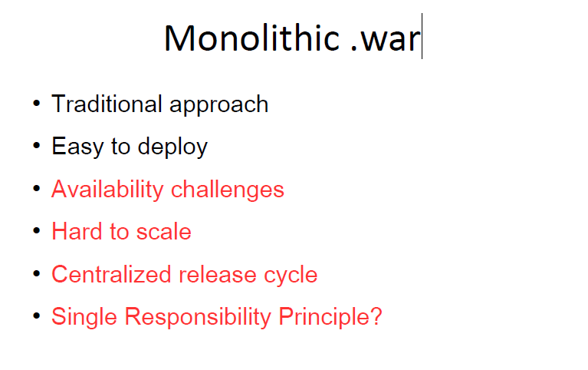
Monolithic

Slide 3
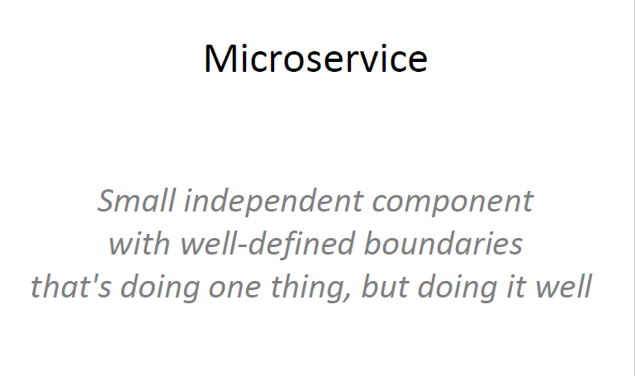
What are micro services ?

Slide 4
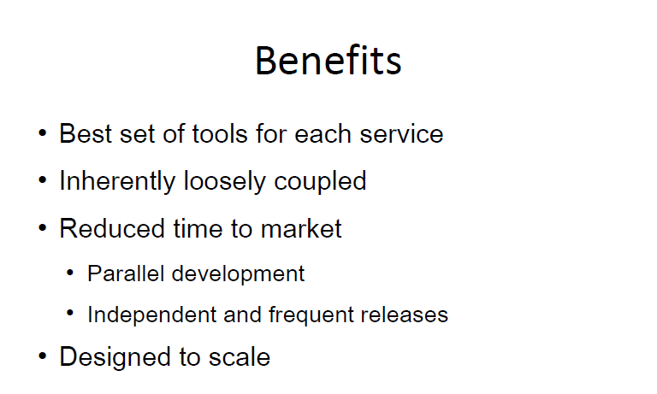
Advantages

Slide 5
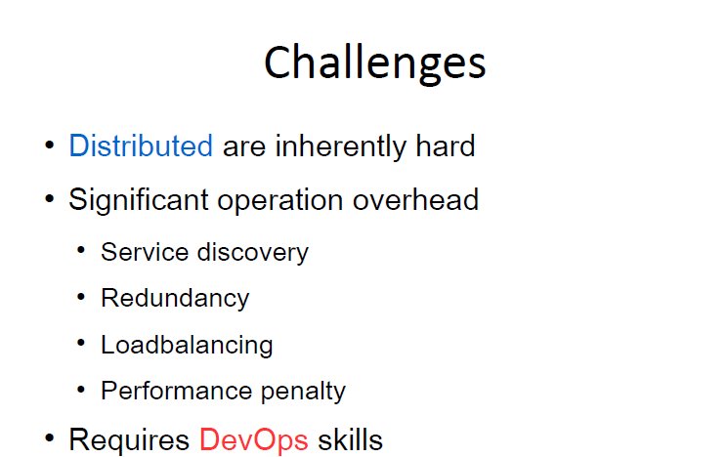
Challenges

Slide 6
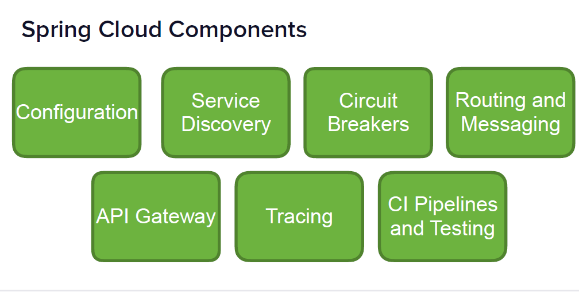
Spring Cloud Components

Slide 7
There are more…..
• Spring Cloud Bus
• Spring Cloud Stream
• Spring Cloud Data and Task
• Spring Cloud AWS
….and more

Slide 8
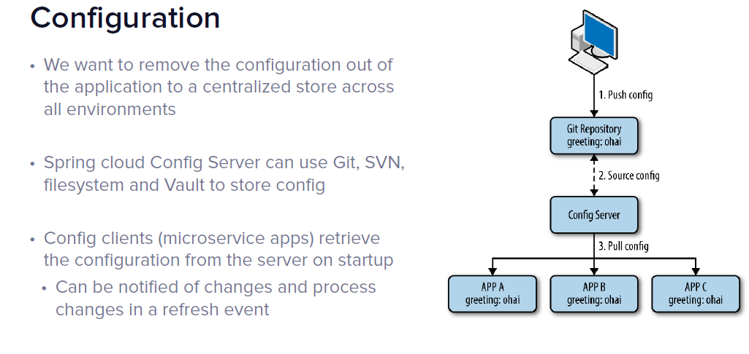
Configuration- Spring-Cloud-Config Spring Cloud Config provides server and client-side support for externalized configuration in a distributed system. With the Config Server you have a central place to manage external properties for applications across all environments. Modules can have common global properties which are repeated in all the modules. For example we have have properties related to Database, Messaging Queues etc.

Slide 9
How Spring Cloud Config Works?
Spring Cloud Config Server can be either configured in following 2 ways-
Using Local File System - Properties to be externalized are stored in the local file system of the Spring Cloud Config Server.
Using GIT Repo - Properties to be externalized are stored in the GIT Repo.

Slide 10
Client-side service discovery and load balancing via Spring Cloud Netflix Eureka.
In a typical microservice architecture we have many small applications deployed separately and they often need to communicate with each other. Specifically, when we say client service, we mean a service that needs to make REST calls to some other end service.
The problem in this type of architecture is how the client service finds all of its end services. We could hardcode the hostname/port in some property file, but this isn't always practical or feasible in a cloud environment. There could be any number of microservices, and it's time and resource-consuming to hard-code when there's an uncertain amount of them, and when their locations may change.
To further add to the complexity, services could have multiple instances of themselves (based on the load). Which instance will actually serve the response could be challenging as we want to have equal load distribution.
Netflix Eureka
Netflix Eureka is a lookup server (also called a registry). All the microservices in the cluster register themselves to this server.
When making a REST call to another service, instead of providing a hostname and port, they just provide the service name.
The actual routing is done at runtime along with equally distributing the load among the end services. There are other service discovery clients like Consul, Zookeeper etc

Slide 11
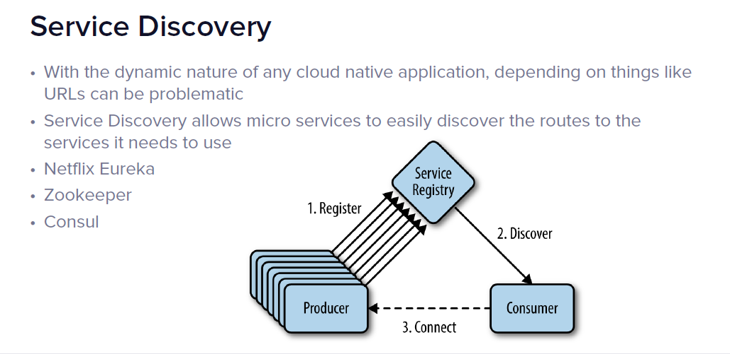
Service Discovery

Slide 12
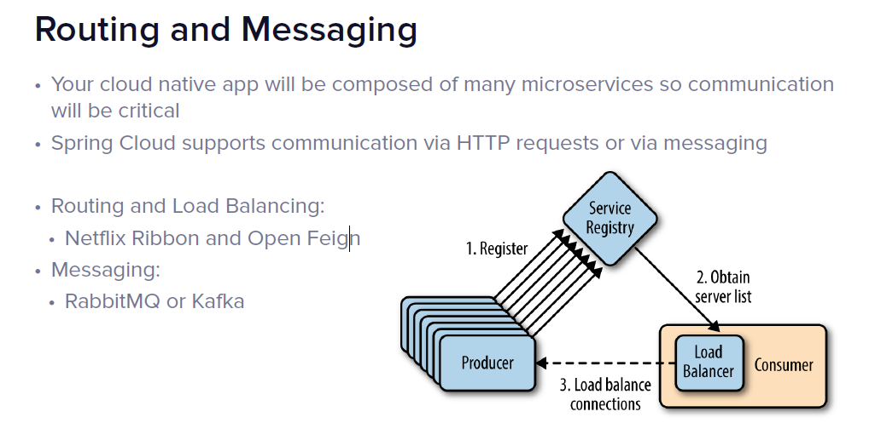
Routing and Messaging

Slide 13
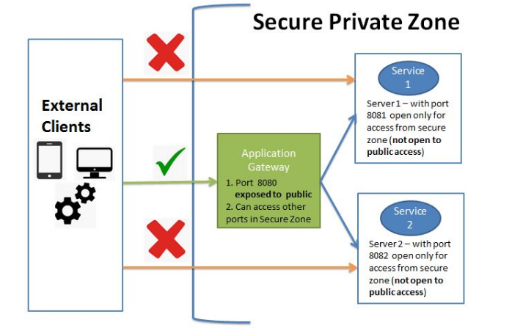
What is an API Gateway? Why do we need it?
An API Gateway acts as a single entry point for a collection of microservices. Any external client cannot access the microservices directly but can access them only through the application gateway In a real world scenario an external client can be any one of the three-
Mobile Application
Desktop Application
External Services or third party Apps

Slide 14
The advantages of this approach are as follows-This improves the security of the microservices as we limit the access of external calls to all our services.
The cross cutting concerns like authentication, monitoring/metrics, and resiliency will be needed to be implemented only in the API Gateway as all our calls will be routed through it.
The client does not know about the internal architecture of our microservices system. Client will not be able to determine the location of the microservice instances.
Simplifies client interaction as he will need to access only a single service for all the requirements.
Spring Cloud Gateway Architecture
Spring Cloud Gateway is API Gateway implementation by Spring Cloud team on top of Spring reactive ecosystem. It consists of the following building blocks-Route: Route the basic building block of the gateway. It consists of
ID
destination URI
Collection of predicates and a collection of filters
A route is matched if aggregate predicate is true.
Predicate: This is similar to Java 8 Function Predicate. Using this functionality we can match HTTP request, such as headers , url, cookies or parameters.
Filter: These are instances Spring Framework GatewayFilter. Using this we can modify the request or response as per the requirement.

Slide 15
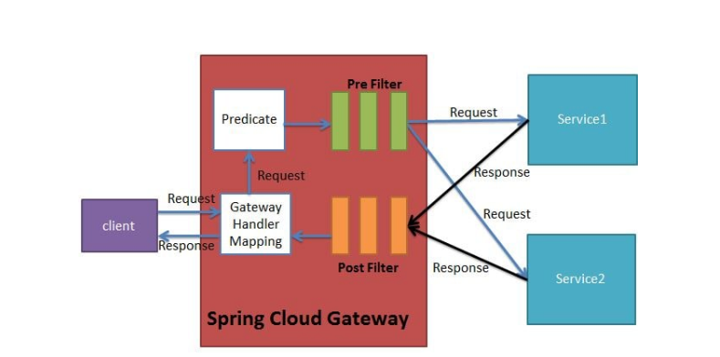
When the client makes a request to the Spring Cloud Gateway, the Gateway Handler Mapping first checks if the request matches a route. This matching is done using the predicates. If it matches the predicate then the request is sent to the filters.
Implementing Spring Cloud Gateway
Using Spring Cloud Gateway we can create routes in either of the two ways -Use java based configuration to programmatically create routes
Use property based configuration(i.e application.properties or application.yml) to create routes.

Slide 16
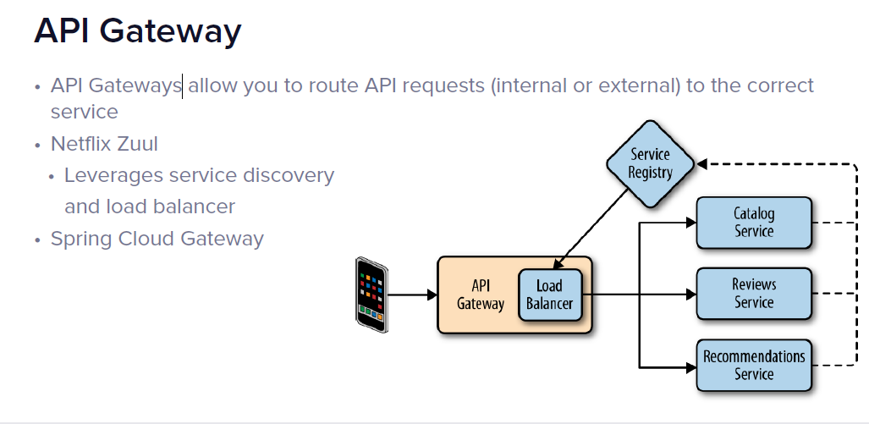
API Gateway

Slide 17
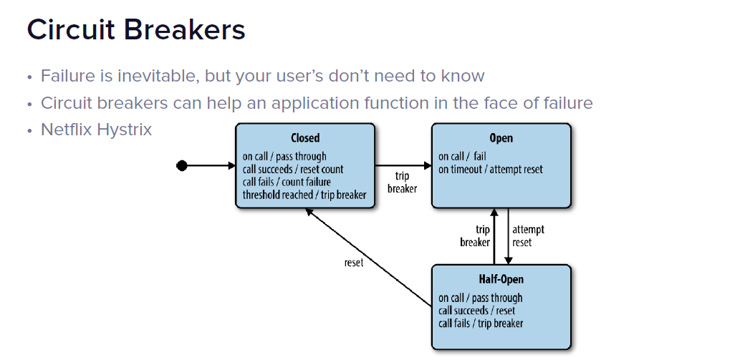
Circuit Breaker

Slide 18
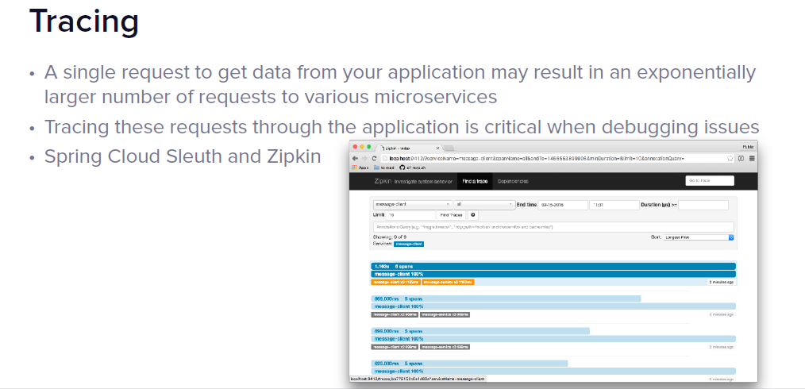
Tracing

Slide 19
API – Student Course
API 1 : Get All Course for the user
API 2 : Register student for a course
--- course should have available seats
--- course is not expired
--- student should not have already registered for the course
API 3 : Get Registered Courses --- username
API 4: Get Students by User Name ---- username

Slide 20
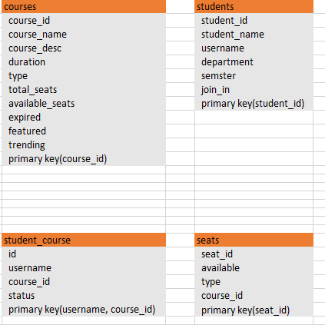
Database

